Slide 1
Elasticity

Slide 2
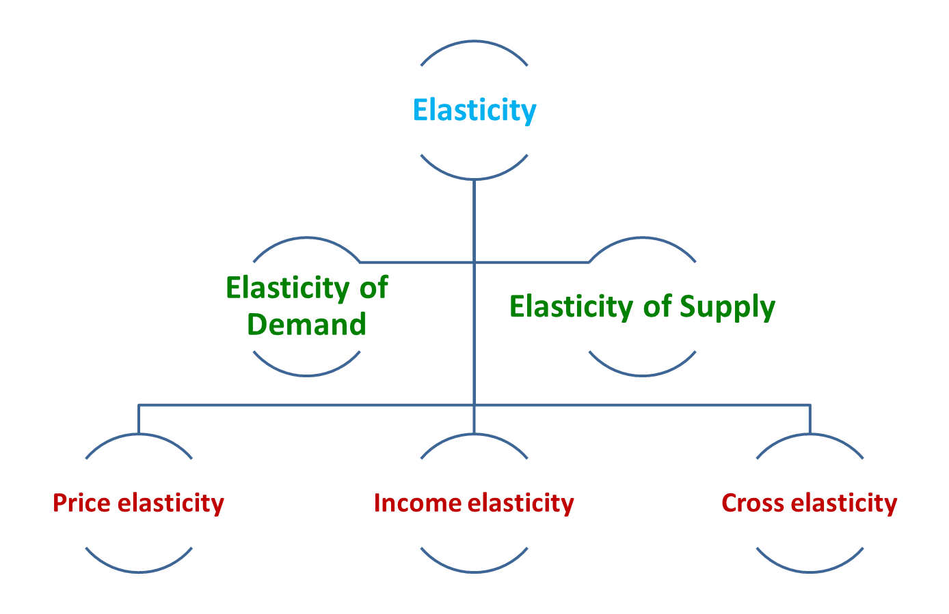

Slide 3
Price elasticity of demand
The law of demand says...
Consumers will buy more when prices go down and less when prices go up
How much more or less?
Does it matter?
To whom?
Price Elasticity Provides an Answer

Slide 4
Price elasticity of demand
Measures Responsiveness to Price Changes
P
The percentage change in quantity demanded
The percentage change in price
P₂
P₁
D
Q₂
Q₁
Q

Slide 5
Price elasticity of demand
Percentage change in quantity
demanded of product X
E_{d} =
Percentage change in price
of product X

Slide 6
Why Use Percentages?
Because, using absolute changes, our choice of units would arbitrarily affect our impression of buyer responsiveness:
  With a 1 rupee reduction in the price of a bag of popcorn, consumers increase their consumption from 60 to 100 bags (a 1 unit price change causes a 40 unit quantity change)
  If we change the monetary unit from rupees to paise, now it appears that it takes a price change of 100 units to cause the 40 unit quantity change

Slide 7
Price elasticity of demand
The Midpoint Formula
Change in quantity
÷
E_{d}
=
Change in price
Sum of Quantities/2
Sum of prices/2

Slide 8
Why we are using mid-point formula??

Slide 9
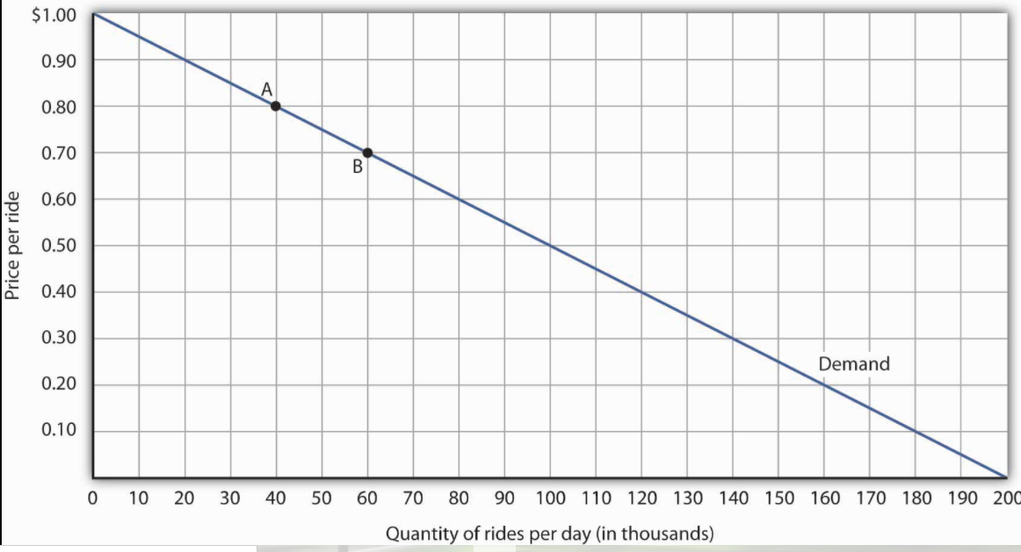

Slide 10
We use mid-point or arc method
First : % change in quantity between point A and B
  Change in quantity= 20,000
  Average quantity= (60,000+40,000)/2= 50,000
  Percentage change in quantity= (20,000/50,000) * 100= 40%
Second: % change in Price
  Change in price=0.8-0.7= -0.1
  Average price= (0.8+0.7)/2=0.75
  Percentage change in price= (-0.1/0.75)*100=-13.33%
Price elasticity of demand= 40/-13.33= -3

Slide 11
Interpretations of E_{d}
Elastic Demand: larger % change in QD
.04
E_{d} =
= 2
.02
Inelastic Demand: smaller % change in QD
.01
E_{d} =
= .5
.02
Unit Elasticity: same change in Qd
.02
E_{d} =
= 1
.02

Slide 12
Extreme Cases
Perfectly Inelastic Demand
P
D₁
E_{d} = 0
0
Q
Perfectly Elastic Demand
P
D₂
E_{d} = ∞
0
Q

Slide 13
Price Elasticity along a Linear Demand Curve
Elasticity typically varies over different price ranges of the same demand curve.
* For all down sloping straight-line demand curves, demand is more price-elastic toward the upper left than the lower right.
P
Unit
Elastic
Elastic
Demand
Inelastic
Demand
Q

Slide 15
For each of the pairs of points, the changes in price and quantity demanded are the same.
For high prices and low quantities→ the percentage change in quantity is relatively large, whereas the percentage change in price is relatively small.
The absolute value of the price elasticity of demand is thus relatively large

Slide 16
Price Elasticity of Demand and the Shapes of Demand Curves
The Relationship between Elasticity and Slope
  If a demand curve has a constant slope (straight-line), the elasticity is not constant.
  If a demand curve has a constant elasticity (unit elastic), the slope is not constant.

Slide 17
Total Revenue and Ed
Total Revenue (TR) = P x Q
When price changes…
  If TR changes in the opposite direction from price, demand is elastic.
  If TR changes in the same direction as price, demand is inelastic.
  If TR does not change when price changes, demand is unit-elastic.

Slide 18
Determinants of price Elasticity of demand
Substitutability: Generally, the more substitute goods available, the greater the price elasticity of demand.
Proportion of Income: Other things equal, the higher the price of a good relative to consumers’ incomes, the greater the price elasticity of demand.
Luxuries versus Necessities: In general, the more a good is considered to be a “luxury”, the greater is the price elasticity of demand.
Time: Generally, product demand is more elastic the longer the time period under consideration. Consumers often need time to adjust to changes in prices.

Slide 19
Cross elasticity of demand
Percentage change in quantitydemanded of good X
E_{xy} =
Percentage change in the price of good y
Positive Sign: Goods are Substitutes
Negative Sign: Goods are Complementary
Zero or Near-Zero Value: Goods are Independent

Slide 20
Income elasticity of demand
Percentage change in quantity demanded
E_{i} =
Percentage change in income
Positive Sign Goods are Normal or Superior
Negative Sign : Goods are Inferior

